Slide 1
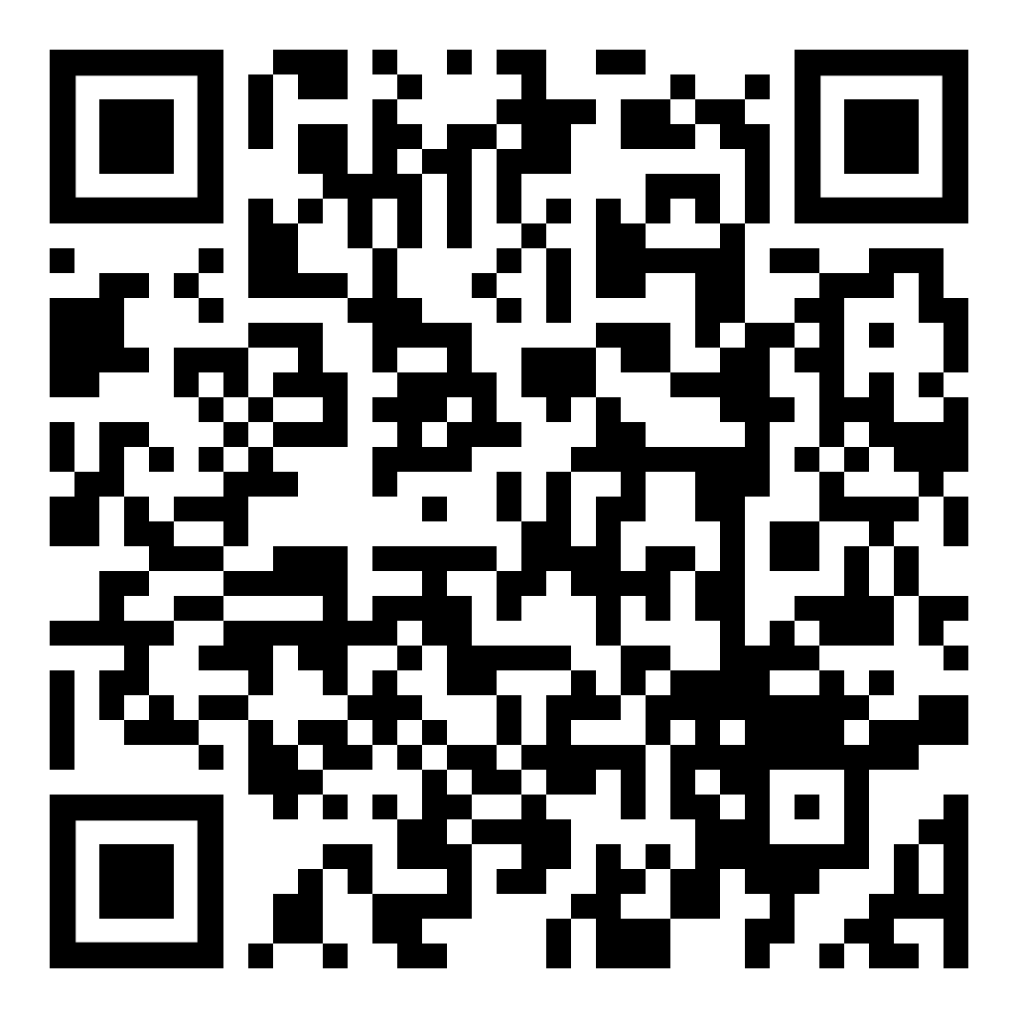
To Claim Attendance
Code is valid for 14 days.
Activity Date: date
Activity Code: code
Go to NortonRSS.com or scan this QR code:
Physicians
Accreditation: Norton Healthcare is accredited by the Kentucky Medical Association to provide continuing medical education for physicians.
Designation: Norton Healthcare designates this live activity for a maximum of 1.00 AMA PRA Category 1 Credit(s) ™. Physicians should claim only the credit commensurate with the extent of their participation in the activity.

