Slide 1
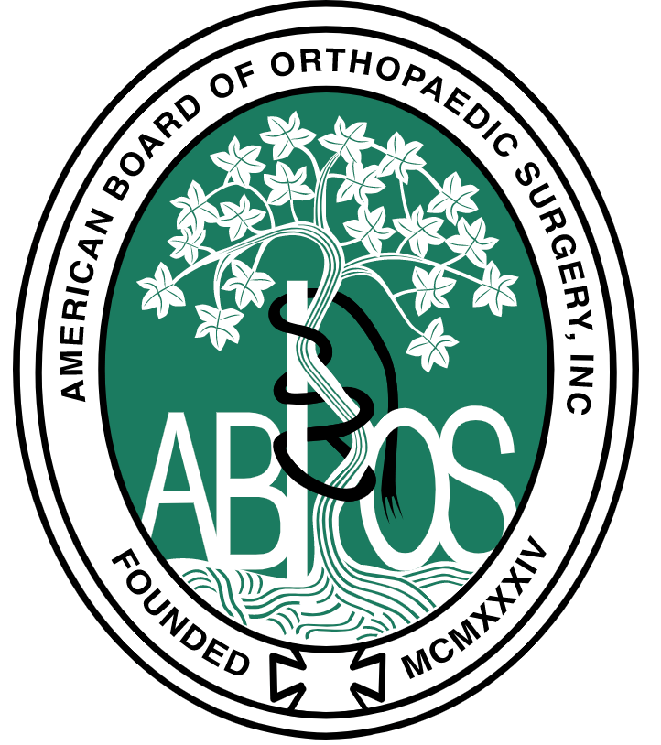
Successful completion of this CME activity, which includes participation in the evaluation component, enables the learner to earn credit toward the CME [and Self-Assessment Examination requirements] of the American Board of Orthopaedic Surgery’s Maintenance of Certification program. It is the CME activity provider's responsibility to submit learner completion information to ACCME for the purpose of granting ABOS credit.
American Board of Orthopaedic Surgery (ABOS) credits

